Slide 1
Aspect-Based Sentiment Analysis using Python
ABAI1010L – Foundations of AI Programming
Name: Sakshi Bohra(A25ARIU0062)

Slide 2
Problem Statement
Traditional sentiment analysis gives only overall sentiment
It does not identify sentiment for specific aspects
Example: “Food is good but service is bad”
Need a system that analyzes sentiment for each aspect

Slide 3
Objective
To build an Aspect-Based Sentiment Analyzer
To classify sentiment as Positive or Negative
To analyze sentiment for specific aspects
To develop a user-friendly web application

Slide 4
Technology Used
python
Streamlit (for web app)
Transformers Library
Pre-trained NLP Model (DistilBERT)

Slide 5
Methodology
users enters sentence
User provides aspects
Model analyzes overall sentiment
Model analyzes each aspect separately
Results are displayed on the web interface

Slide 6
Implementation
Used Hugging Face Transformers
Loaded sentiment analysis pipeline
Built UI using Streamlit
Integrated model with web interface

Slide 7
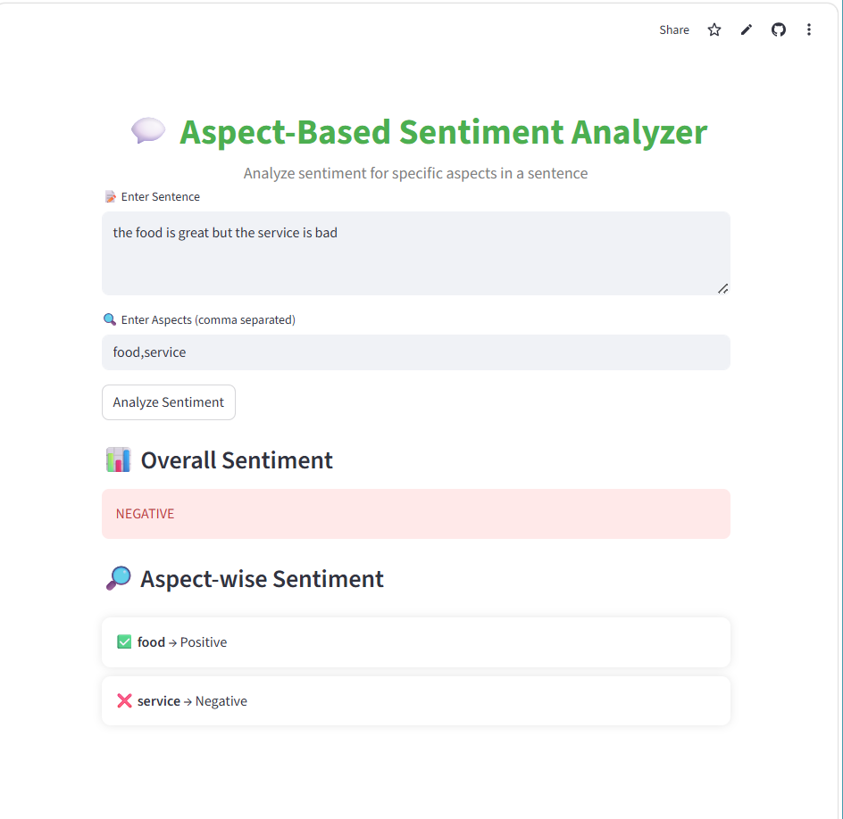
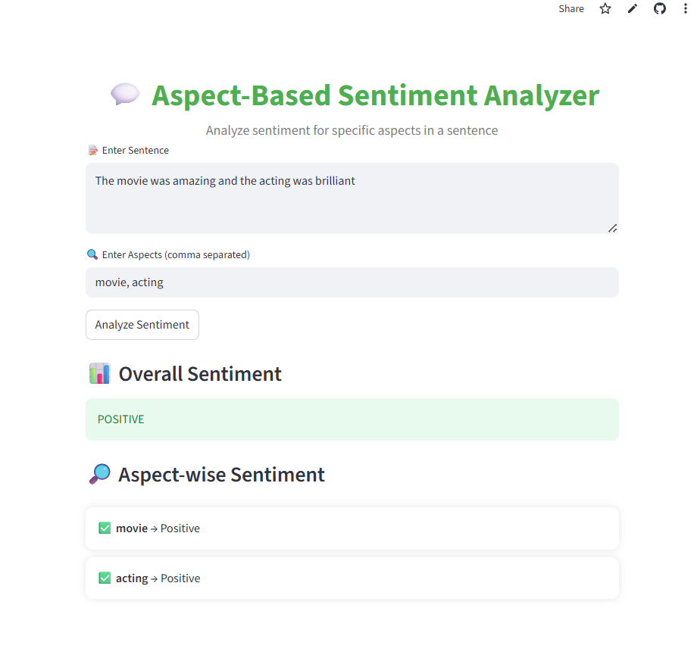
Experimental Results

Slide 8
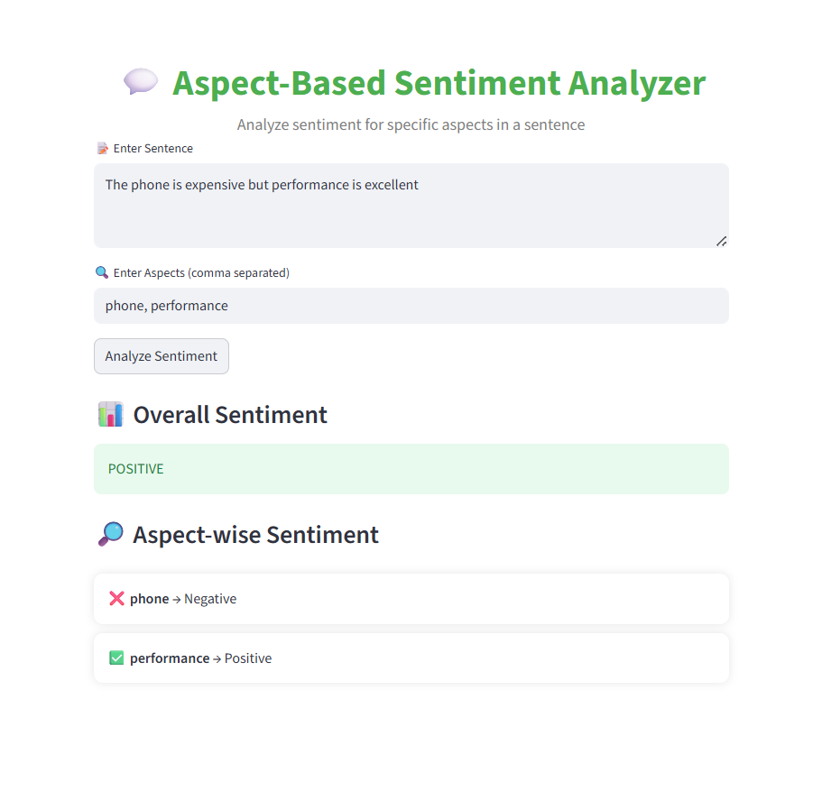
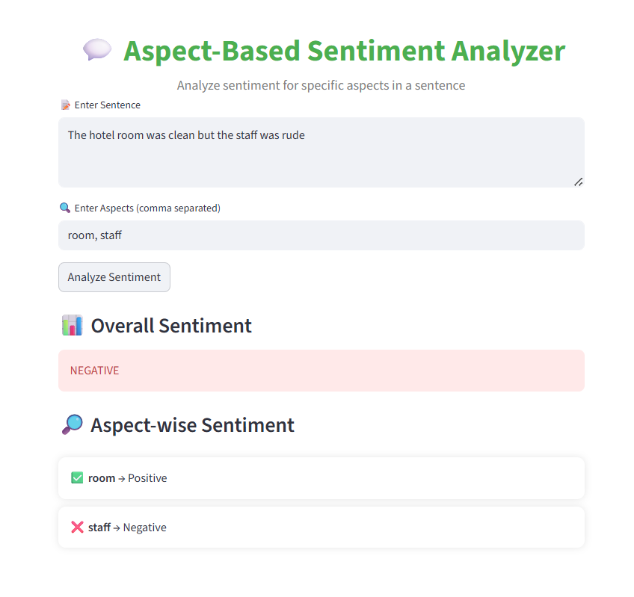
Experimental Results

Slide 9
Experimental Results
Model successfully identifies sentiment
Works for multiple aspects
Provides accurate results for simple sentences
Limitation is complex sentences.

Slide 10
Advantages
More detailed than basic sentiment analysis
Easy to use interface
Real-time analysis
Can be further extended

Slide 11
Limitations
Difficulty with complex sentences
Depends on pre-trained model accuracy
Limited context understanding

Slide 12
Future Scope
Improve accuracy using advanced models
Add multilingual support
Deploy as mobile application
Integrate with real-world data

Slide 13
GitHub and Deployment
GitHub Link: bohrasakshi79-ux/dimabsa-project
Deployment Link: Sentiment Analyzer · Streamlit

Slide 14
Conclusion
Successfully developed ABSA system
Implemented using NLP techniques
Deployed as web application
Provides useful insights for users

